Slide 1
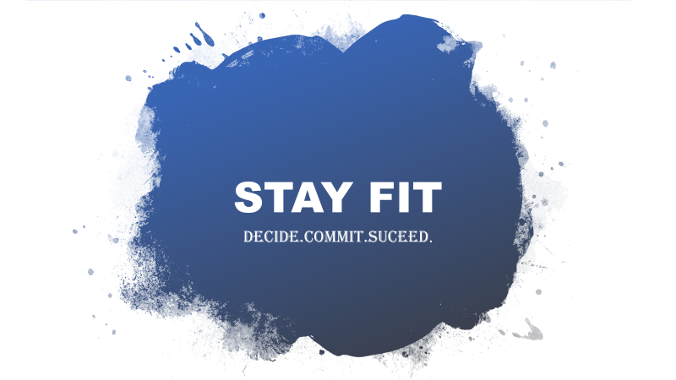
STAY FIT
DECIDE.COMMIT.SUCEED.

Slide 2
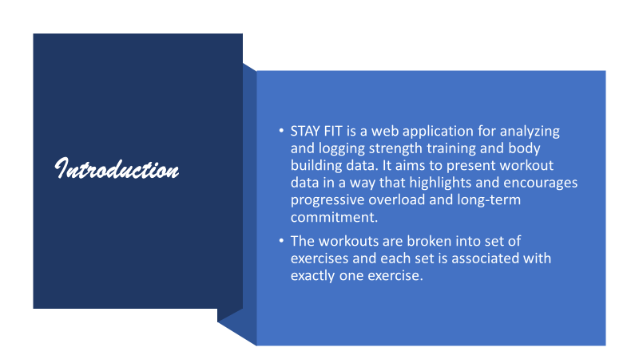
Introduction
STAY FIT is a web application for analyzing and logging strength training and body building data. It aims to present workout data in a way that highlights and encourages progressive overload and long-term commitment.
The workouts are broken into set of exercises and each set is associated with exactly one exercise.

Slide 3
Literature Survey
https://www.ncbi.nlm.nih.gov/pmc/articles/PMC6604512/
The above research given was conducted in two phases. Through a survey and 2 workshops, this paper contains information on understanding of young people’s perceptions of healthy eating and fitness apps and any potential harm that their use might have and also explored these further through interviews with experts in eating disorder and body image. Using insights drawn from this initial phase. This paper also have a review of the top 100 healthy eating apps.

Slide 4
Features
Exercise portal:
Simple workout data entry supporting reps, sets, weight, duration, warmup and actual workouts
Exercise search
Supports multiple workouts per day
Track and visualize our workout data
Lots of charts
Muscular visualizations (using svg files)
Intensity and volume calculations
Import
Export
Proper time zone support (important for people who travel)

Slide 5
Recommendations portal:
Recommendations according to user’s weight
3 different subscription plans
Payment gateway (integrated Paypal)
User friendly chatbot for clarifying user’s doubt
Admin portal:
Dashboard
Perform certain actions like insertion, deletion and updation.
Workout recommendations
Food recommendations
Workout tutorials

Slide 6
Software Requirements
FRONTEND: HTML, JS, jQuery.
STYLING: CSS, Bootstrap.
BACKEND: MySql , Indexed DB.
Connecting frontend and backend : PHP

Slide 7
Indexed DB : Used for storing performed exercises
-> Indexed DB stores data in key and value pairs.
Key : id
Value : metrics

Slide 8
MySql : Used for admin portal
Admintable : stores admin userid and password
Usersrc : stores user login details
Foodtable : stores food recommendations
Workoutstable : stores workout recommendations
Tutorials : stores tutorial videos
Chatbot_hints : stores chatbot questions and answers
Feedback : stores feedback of different users
Plans : stores subscription plans details

Slide 9
Important terms:
1) Reps: Reps, short for repetitions, are the action of one complete strength training exercise.
2) Sets: Sets are how many reps you do in a row between period of time. (nothing but the count of exercises)
3) Weight: The weight you lift

Slide 10
In weight training there are two metrics that matter most:
Volume: Volume is just the total weight moved, calculated by multiplying the reps and weight and summing that for all sets.
For example (sum):
1 set of 5 reps @ 225 kgs(initial)
volume = 5*225 = 1,125
1 set of 5 reps @ 275 kgs
volume = 5*275 = 1,375 + 1125 = 2,500
1 set of 5 reps @ 250 kgs
volume = 5*250 = 1,250 + 2500 = 3,750
1 set of 5 reps @ 2000 kgs
volume = 5*2000 = 10,000 + 3,750 = 13,750
For example (avg):
Total = 1125 + 1375 + 1250 + 10000
Avg = 13750/4 = 3,437.5
For example (max):
Max(1125,1375,1250,10000)
= 10,000

Slide 11
2) Intensity: Intensity is how heavy the lift was compared to past performance.
For example (max):
1 set of 5 reps @ 225 kgs (initial)
past – 225, present - 225
intensity = 225/225 = 1
1 set of 5 reps @ 275 kgs
past – 225, present – 275
intensity = 275/225 = 1.22
here 1.22>1 so updates to 1.22
1 set of 5 reps @ 250 kgs
past – 275, present - 250
intensity = 250/275 = 0.90
here 0.90<1.22 so no change
1 set of 5 reps @ 2000 kgs
past – 275 (no change before), present – 2000
intensity = 2000/275 = 7.27
here 7.27>1.22 so updates to 7.27

Slide 12
For example (avg):
Total = 1 + 1.22 + 0.90 + 7.27 = 10.39
Avg = 10.39/4 = 2.597
3) Duration (active) : total duration of all exercises

Slide 13
CONCLUSION
STAY FIT web application hence acts as an ultimate fitness tracker for the users who wants to keep track of their daily or weekly progress of workouts like their intensity, number of sets, number of reps, time duration etc...For the beginners who are new to any form of workouts will have a separate portal where they can select their plans and workout accordingly. Staying fit does not only mean doing workouts, it must also include a proper diet. This web application also provides a diet (Breakfast, Lunch and Dinner)based on the user's weight.
The website can be further extended to an app in the future as a part of development of our project. Moreover, additional functionalities can be added like online training sessions and monthly/yearly food subscriptions of your diet delivered to the user.

Slide 14
THANK YOU

